Slide 1

Introduction to Computer Science: Programming Methodology
Tutorial 10
Algorithm aNALYSIS

Slide 2
Primitive operations
Counting primitive operations:
~ Assigning an identifier to an object
~ Performing an arithmetic operation
~ Comparing two numbers
~ Calling a function
…
Measuring operations as a function of input size.
To capture the order of growth of an algorithm’s running time, we will associate, with each algorithm, a function f(n) that characterize the number of primitive operations as a function of input size.

Slide 3
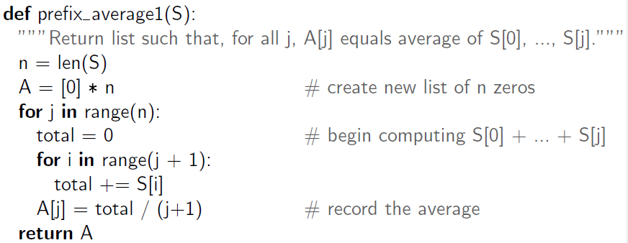
An quadratic-time algorithm
Example:
O(1)
O(n)
O(n)
n(n+1)/2->O(n²)
O(n)
The running time of this program is O(n²): quadratic-time algorithm

Slide 4
Q1: Verify 8nlogn better than 2n²
In this tutorial, logn means log₂n.

Slide 5
Q2: Verify 40n² better than 2n³

Slide 6
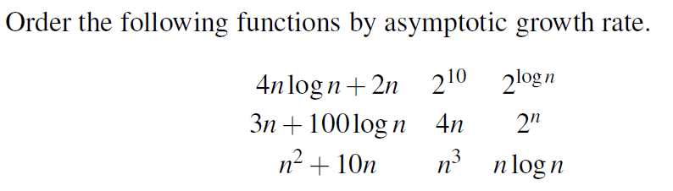
Q3: Ordering functions asymptotically
Hints: Using Matlab, Python(download matplotlib module) or Excel to plot the graph of each function for n in the range [0,10], [0,100], [0,1000] respectively.

Slide 7
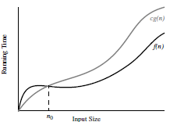
Definition of Big-Oh Notation
Definition: Let f(n) and g(n) be functions mapping positive integers to positive real numbers. We say that f(n) is O(g(n)) if there is a real constant c>0 and an integer constant n₀≥1 such that
f(n)≤cg(n), for n ≥ n₀
This definition is often referred to as the ‘big-Oh’ notation, for it is sometimes pronounced as ‘f(n) is big-Oh of g(n).’ Or you can say ‘f(n) is order of g(n)’.

Slide 8

Q4: Prove Big Oh of a function
Use the definition of Big Oh notation shown before to
i) Show that 8n+5 is O(n).
ii) Show that 5n⁴+3n³+2n²+4n+1 is O(n⁴).
iii) Show that 5n²+3nlogn+2n+5 is O(n²).
iv) Show that 16nlogn+n is O(nlogn).
Rules: Characterizing functions in simplest terms.
Use the 7 functions. Our 7 functions are ordered by increasing
growth rate in the following sequence.
better
worse

Slide 9
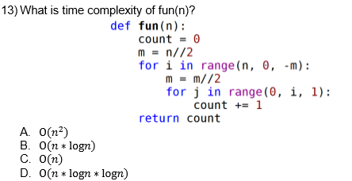
Q5: Time Complexity

Slide 10
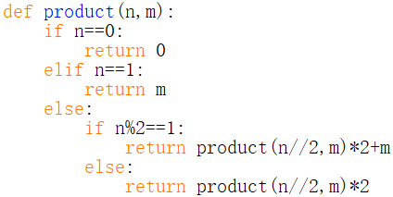
Q6:Time complexity
i)What is the functionality of the function product()?
ii)What is the time complexity of this function?

